Slide 1
CS 419: Production Rendering Viewing
Eric Shaffer

Slide 2

Perspective Viewing
You probably already know most of this…but let’s review
Perspective viewing produces images that seem realistic
It’s similar to how our eyes work
Ortho is not how our eyes work

Slide 3
Definitions
A projection (for CG): transforms 3D points in space into 2D points on a view plane
Points are transformed along straight lines called projectors
In perspective projection, they converge to a point called the center of projection

Slide 4
Definitions
The view volume is an infinite 4-sided pyramid
Corners of the viewport define the sides of the pyramid
Apex is at the CoP (center of projection)

Slide 5
Definitions
In a general perspective viewing system the following are arbitrary:
location of CoP
location of the view plane
orientation of the view plane
We’ll use a special case:
center of projection and center of the viewport define view direction
view plane is perpendicular to this view direction

Slide 6
Definitions
Do we need to do clipping?
Field of view is the angle subtended at the CoP by the bottom and top of the viewport

Slide 7
Properties of the Perspective Projection
The projection of an object gets smaller as the object gets farther away from the CoP
The perspective projection preserves straight lines

Slide 8
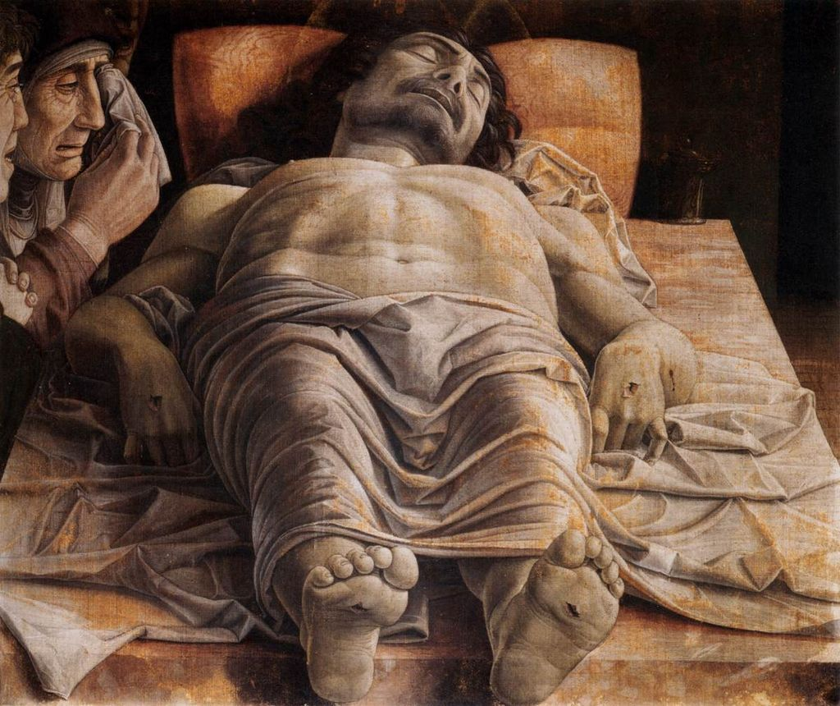
Properties of the Perspective Projection
Foreshortening: the size of an object's dimensions along the line of sight appear relatively shorter than dimensions across the line of sight
Andrea Mantegna, The Lamentation over the Dead Christ
1480

Slide 9
Properties of the Perspective Projection
When they are parallel to the view plane, the projection preserves parallel lines
When they are NOT parallel to the view plane, parallel lines converge to a vanishing point on the view plane

Slide 10
The Horizon and Vanishing Points

Slide 11
2-Point Perspective
Notes:
Used in architectural drawings…this is an artistic distinction based in the objects in the image and their orientation

Slide 12
3-Point Perspective
If a set of parallel lines is parallel to a world coordinate axis, the vanishing point is called a principal vanishing point

Slide 13
Axis-Aligned Perspective Viewing
view direction parallel to the z axis
…if we trace rays from an eyepoint, we get perspective projection
in orthographic projection the rays have different origins but the same direction
in perspective projection the rays have the same origin and different directions

Slide 14
Axis-Aligned Perspective Viewing
We need to specify a distance d from the eye to the view plane
Given h_{res},v_{res}, pixel size s the ray directions will be:
(s(c-h_{res}/2 +0.5), s(r-v_{res}/2+0.5),-d)

Slide 15
Perspective Effects
What camera action does varying d have?
Notes:
Increasing d is like a zoom

Slide 16
Perspective Effects
What action does the projection have on object size?
What if the object is between the viewplane and eyepoint?

Slide 17
Perspective Effects
What action does the projection have on object size?
What if the object is between the viewplane and eyepoint?

Slide 18


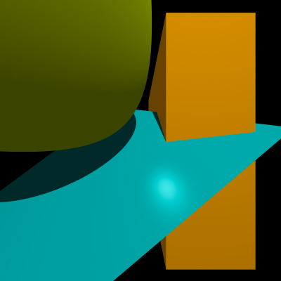
Perspective Effects
How about when we fix d and vary the eyepoint?
Notes:
What do you notice?

Slide 19
Perspective Distortion
Caused by the view plane being flat
Our retinas are spherical
So we don’t see it

Slide 20
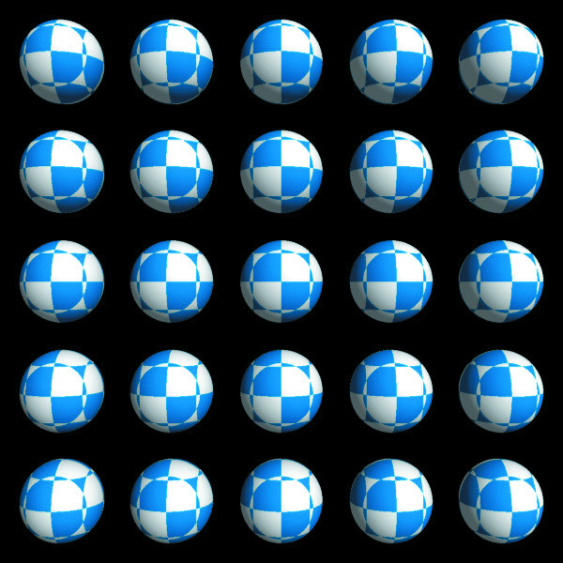

Perspective Distortion
Notes:
Somce question

Slide 21
Some questions
How can you zoom in an orthographic projection?
Would a plane not parallel to the view direction have a horizon?

Slide 22
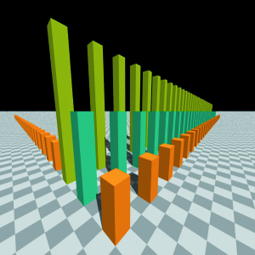
Viewing
What we’ve seen so far is restrictive
…let’s lift the restrictions
Let’s implement a virtual pinhole camera

Slide 23
Virtual Pinhole Camera
We have the following parameters
eyepoint
view direction
orientation around the view direction
distance to the view plane

Slide 24
Compare with a Real Pinhole Camera
What is the difference? What is the effect?

Slide 25
Setting up a Viewing Coordinate System
We need to find ray directions through the view plane
We’ll look at the viewplane from a frame
Based at the eyepoint
Defined by the viewing parameters
eye point e
look-at point l
up vector up
view plane distance d
(x_{v},y_{v},z_{v}) are points in this frame

Slide 26
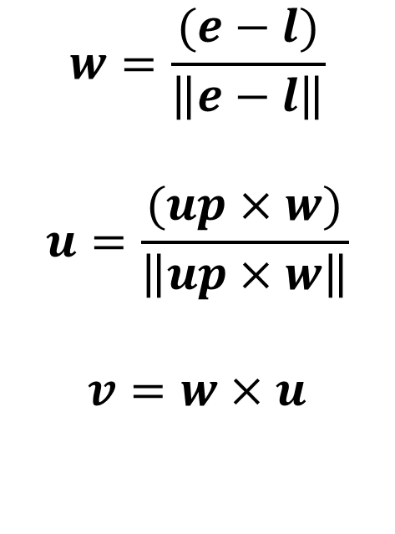
Computing the ONB
ONB= orthonormal basis
$$w=\frac{(e−l)}{\left\|e−l\right\|}$$
$$u=\frac{(up×w)}{\left\|up×w\right\|}$$
$$v=w×u$$

Slide 27
Primary Ray Calculation
Direction u is parallel to pixel rows
Direction v is parallel to pixel columns
Compute x_{v} and y_{v} cords of a point in a pixel on the viewplane:
x_{v}= s(c - h_{res}/2 + p_{x})
y_{v}= s(r - v_{res}/2 + p_{y})
What are p_{x} and p_{y}?
Notes:
for a pixel center it would 0.5 and 0.5
offsets inside the pixel
0,0 lower left pixel corner

Slide 28
Primary Ray Direction
We have (x_{v},y_{v}) in view coordinates
What is the view coordinate in the w direction?
What is the direction vector in world coordinates?
Notes:
-d distance down the view vector to the view plane

Slide 29
Primary Ray Direction
We have (x_{v},y_{v}) in view coordinates
What is the view coordinate in the w direction? We are looking down –w axis The viewplane is d units from the eye So z_{v}=-d
What is the direction vector in world coordinates?
eyepoint is origin, so d_{v}=(x_{v}-0,y_{v}-0,-d-0)
u,v,w are in world coordinates
we have d = x_{v}u+y_{v}v-dw
…need to normalize d
Notes:
-d distance down the view vector to the view plane

Slide 30
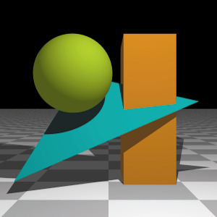
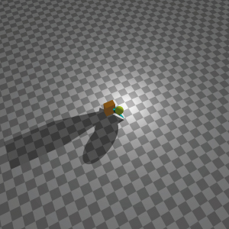
Example

Slide 31
Singularity
For any viewing system, there are pathological parameter values that can break the system.
When does this happen for the parameters we have described?
Notes:
If view direction is parallel to the up direction, u will be zero vector divided by 0

